Slide 1





Bioinformatics workflows for Oxford Nanopore ampliconic data
John A. Juma
Animal and Human Health
International Livestock Research Institute (ILRI)
March, 2023
j.juma@cgiar.org

Slide 2
Objectives
Quality control procedures for ONT MinION data
Reference-guided alignment of NGS data
Variant calling workflows – emphasis on medaka
Learn common terminology in NGS steps and understand concepts of depth and coverage
Consensus sequence building

Slide 3
Primer schemes

Slide 4
Fast5 (Squiggles)
Guppy
Data analysis steps
Raw reads (FASTQ)
FastQC/MultiQC
Quality control (QC)
Minimap2/bwa/flye
Alignment/Assembly
Medaka
Assembly correction
Variant Calling: medaka, nanopolish, BCFTools
Phylogenetics: BEAST, IQTREE, PhyML, FastTree
Downstream Analyses
Annotation: Promoxis
AMR: CARD, PATRIC, Mykrobe, TBProfiler

Slide 5
Artic Bioinformatics pipeline
Basecalling and Preprocessing
Variant filter thresholds
No frameshifts
Minimum depth 20
Min 50% supporting reads in each strand
Basecalling
guppy
_basecaller
Demultiplex
guppy
_barcoder
Size filter
artic
_guppylex
Alignment
Variant calling
Variant call
Primer set 1
medaka variant
Alignment
minimap2/bwa-mem
-ax map-ont
-x ont2d
Filter Alignment
align_trim
Normalise=200x
Remove incorrect primer pairs
Merge VCFs
artic_vcf_
merge
Filter variants
artic_vcf_
filter
Variant call
Primer set 2
medaka variant
Consensus FASTA
Plots
Consensus FASTA bcftools consensus
Create preconsensus
artic_mask
Mask low-coverage
artic_make_depth_mask

Slide 6
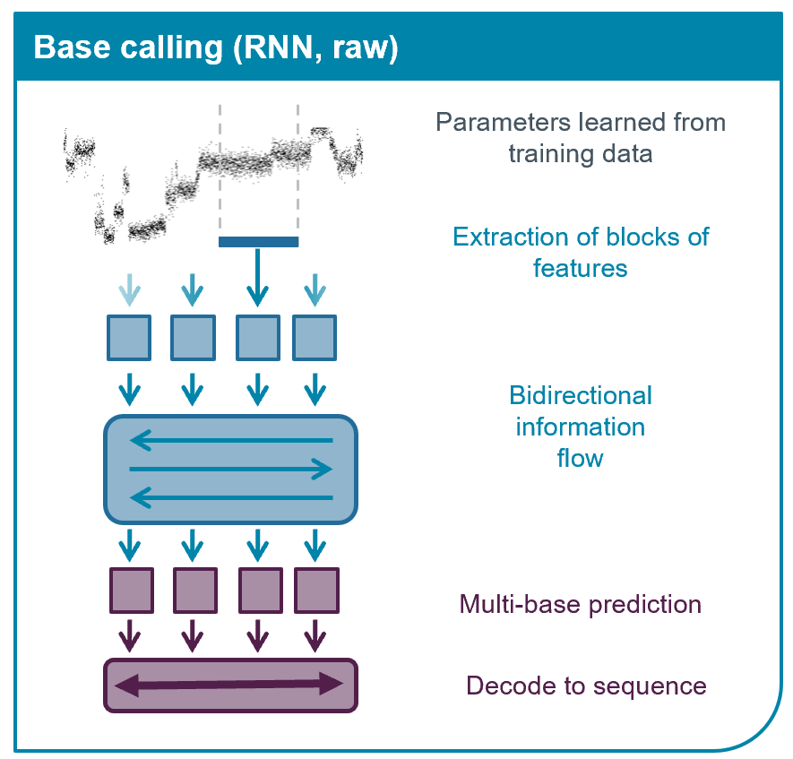
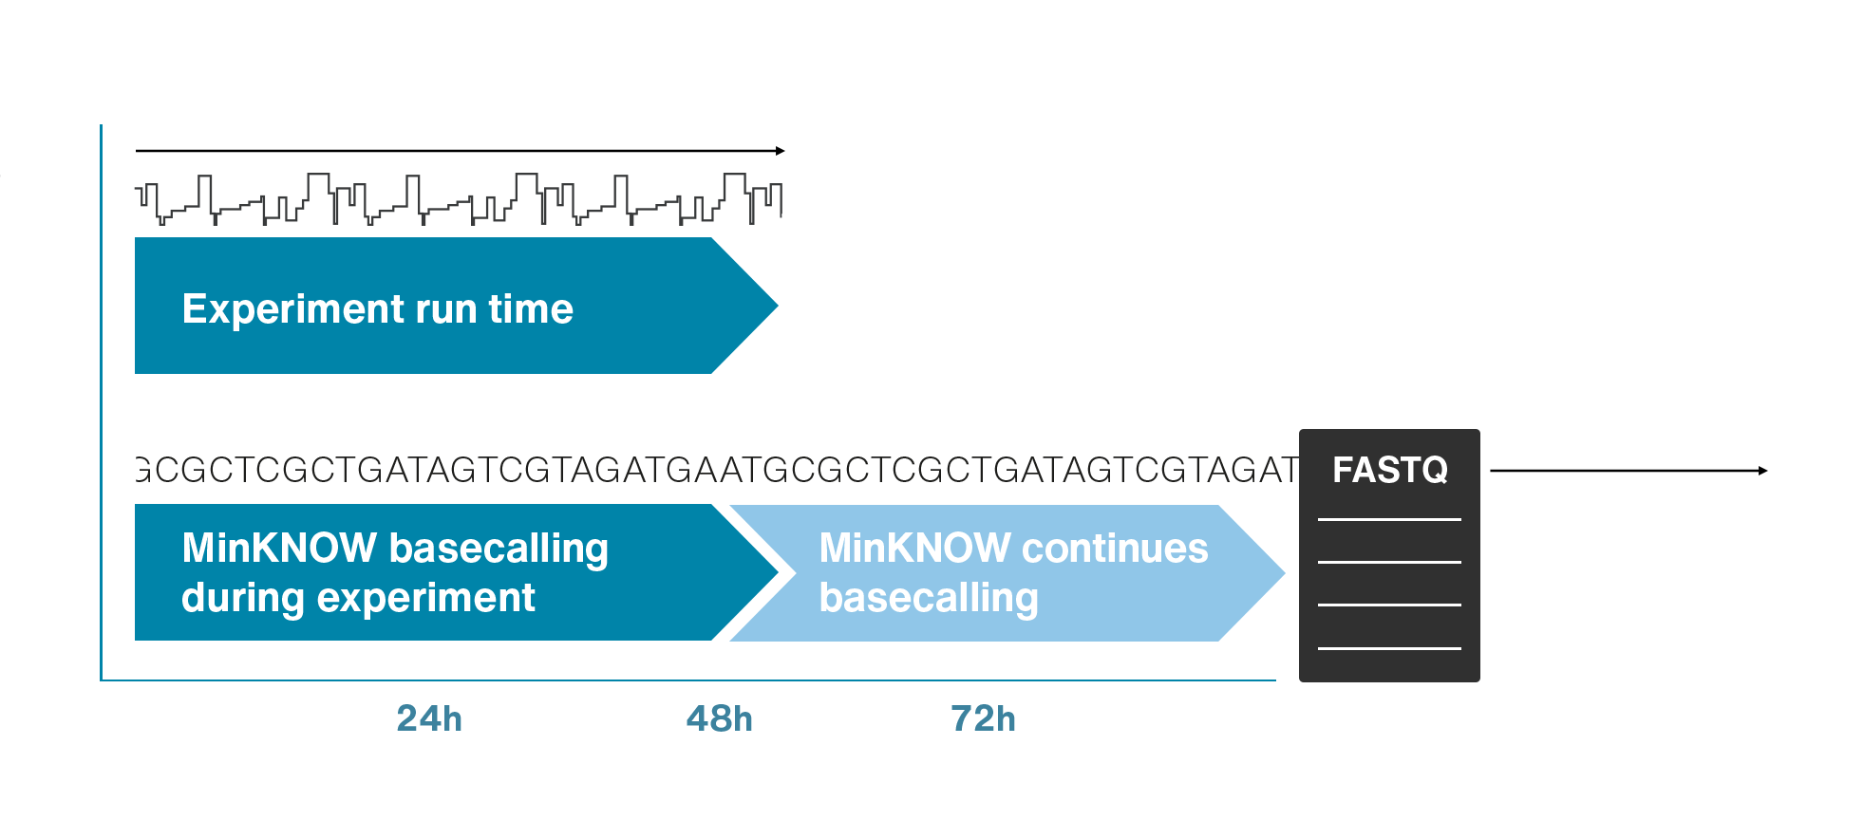
Basecalling
guppy_basecaller: --config dna_r9.4.1_450bps_fast.cfg --barcode_kits "EXP-NBD104 EXP-NBD114” --trim_barcodes).
guppy_barcoder separate fastq files into barcode folders (demultiplexing)
guppy_aligner (under development).
Source: https://nanoporetech.com/how-it-works/basecalling
Notes:
When sequencing DNA or RNA with nanopores, the changes in current caused by the strand of DNA or RNA as it passes through the pore are recorded by the MinKNOW™ software which runs all of Oxford Nanopore's sequencing devices. The processive movement of bases through the pore leads to a continual change in current, known as the “squiggle”. MinKNOW processes the squiggle into reads in real-time, each read corresponding to a single strand of DNA/RNA. These reads are written out into FAST5 files.

Slide 7
Basecalling
Basecalling can be performed “live” or in real time while sequencing.
However, it is often useful to separate the sequencing from basecalling.
One advantage of “offline” basecalling is that the basecaller can use significant amounts of compute and read/write resources which may slow the sequencing process and, in some cases, even lead to loss of sequencing data.
Guppy uses significant amounts of compute resources/time if run on a processor (CPU), especially if using the High-Accuracy (hac) models. Graphical processor units (GPUs) allow for parallelization of the basecalling process.
Predecessor basecallers: Albacore, Metrichor
Source: https://nanoporetech.com/how-it-works/basecalling

Slide 8
Quality control
Quality control on next-generation sequencing (NGS)
On the starting nucleic acid samples (spectrophotometric, fluorometric, Gel electrophoresis, RIN)
After library preparation (Bioanalyzer)
Post-sequencing (FastQC, MultiQC)
The Ultimate best QC will likely come from the sequence data.
Notes:
Before you can use your data for post-analysis, you should check to see if your fastq files pass quality control checks. ONT sequencing is more prone to errors than Illumina and so you have to be more careful. The cut off for depth should be at least 30, but 50-60 is a good minimum. You can get away with lower coverage, but the genome becomes more noisy. This noise can affect downstream applications e.g. variant calls (true SNPs or sequencing error) and phylogenetic trees (more noise = more things filtered out and a less accurate tree).

Slide 9
Quality control
Quality control on next-generation sequencing (NGS)
On the starting nucleic acid samples (spectrophotometric, fluorometric, Gel electrophoresis, RIN)
After library preparation (Bioanalyzer)
Post-sequencing (FastQC, MultiQC)
The Ultimate best QC will likely come from the sequence data.

Slide 10
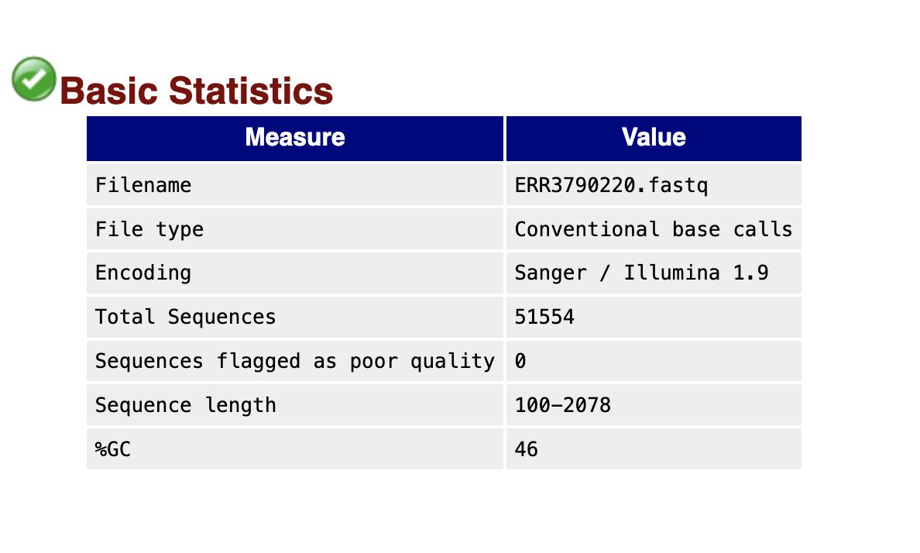
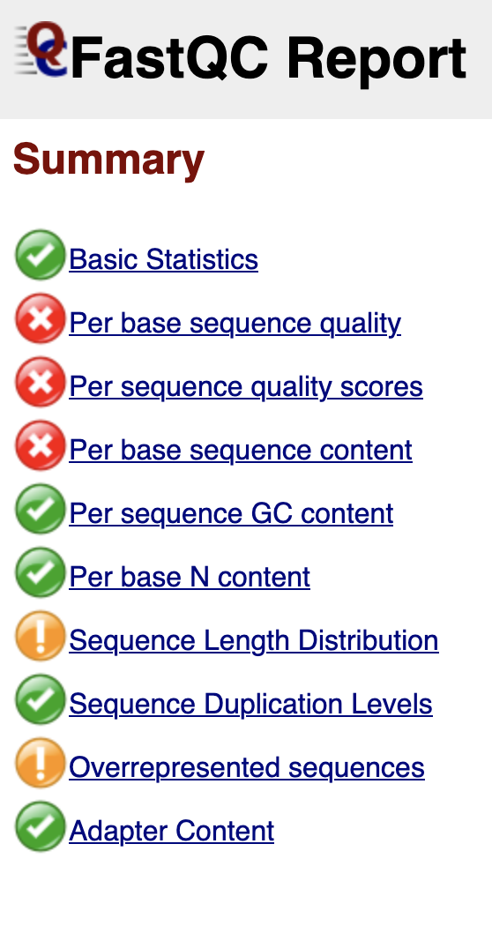
Quality control with FastQC

Slide 11
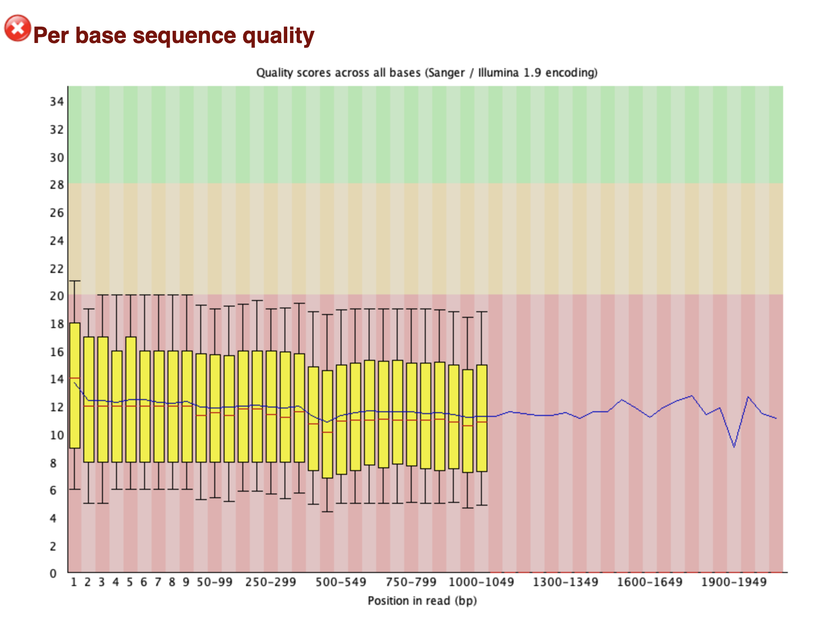
Quality control with FastQC
Per Base sequence quality module
Shows mean and standard deviation of sequencing quality for each position in all reads of the data set.
Shows low quality regions that may have to be removed, low quality reads filtered.

Slide 12
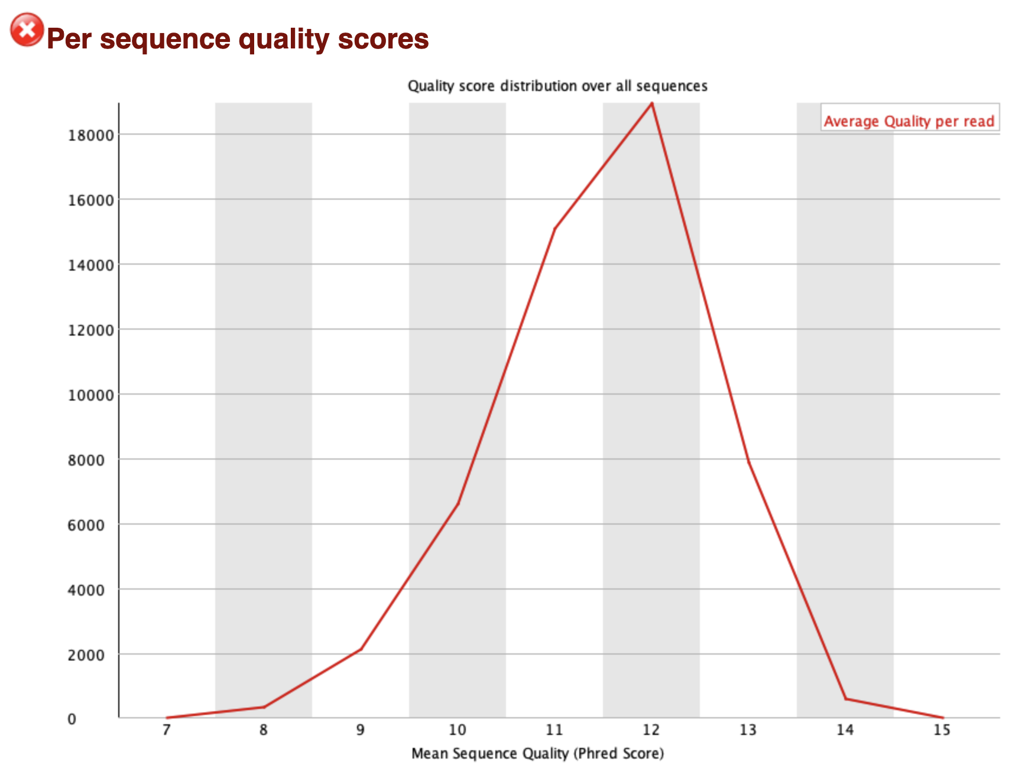
Quality control with FastQC
Per sequence quality scores module
Shows the average quality score distribution of the reads.

Slide 13
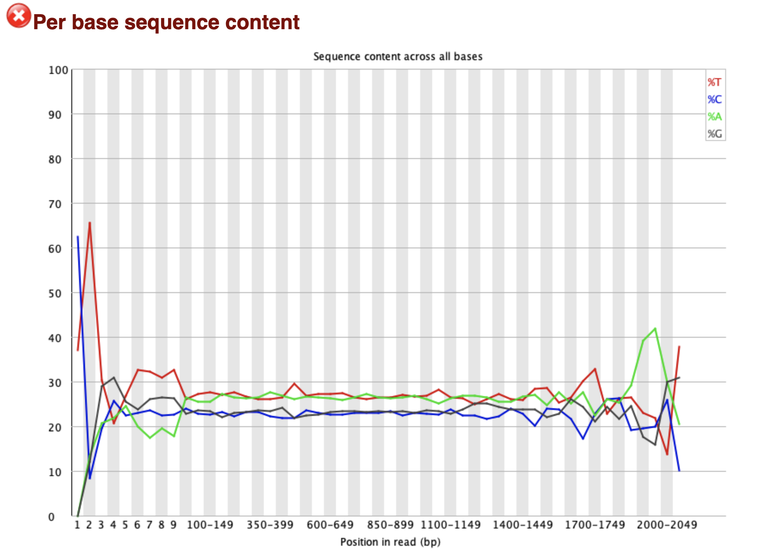
Quality control with FastQC
Per base sequence content module
Show the average ratio of As, Ts, Cs and Gs in your data set. ”Clean” data without sequencing errors should show almost parallel/flat lines for all four nucleotides.
Trailing or leading peaks indicate sequencing problems and may have to be trimmed.

Slide 14
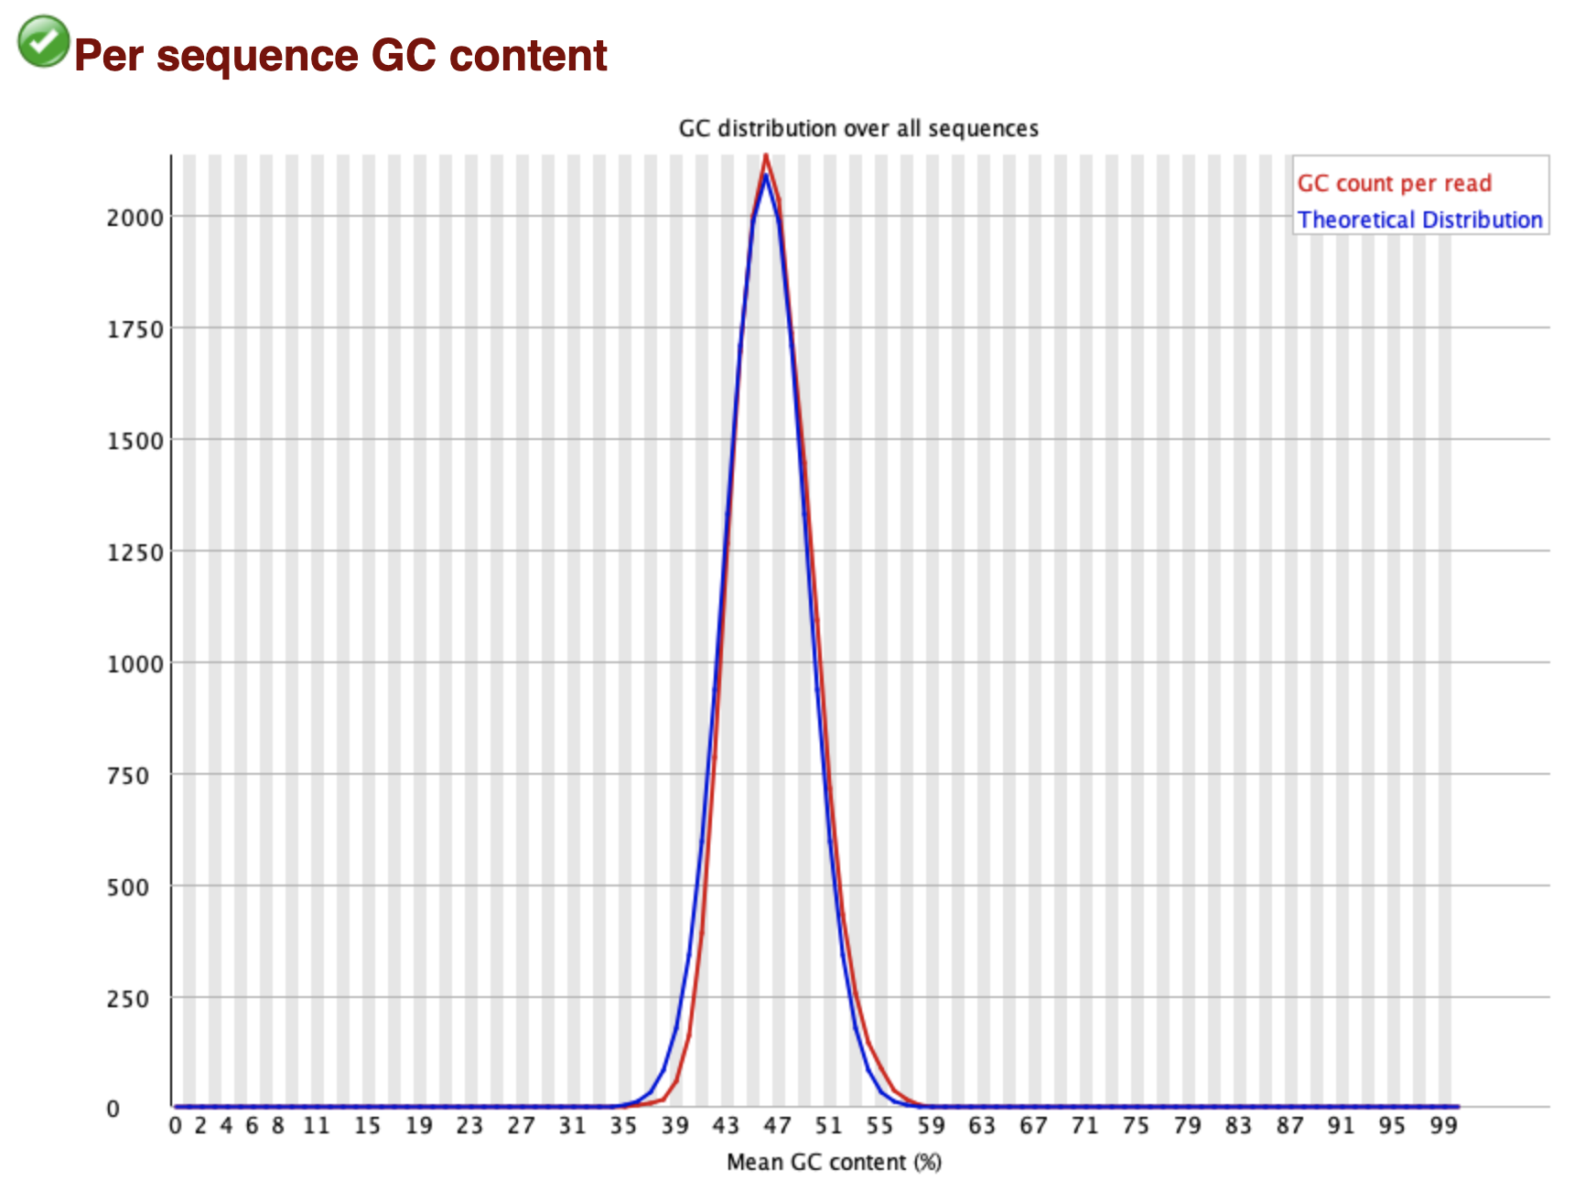
Quality control with FastQC

Slide 15

Aggregating quality reports with MultiQC
file:///Users/jjuma/trainings/africacdc-ilri-aslm-2023/output-dir/denv-1/multiqc/multiqc_report.html

Slide 16
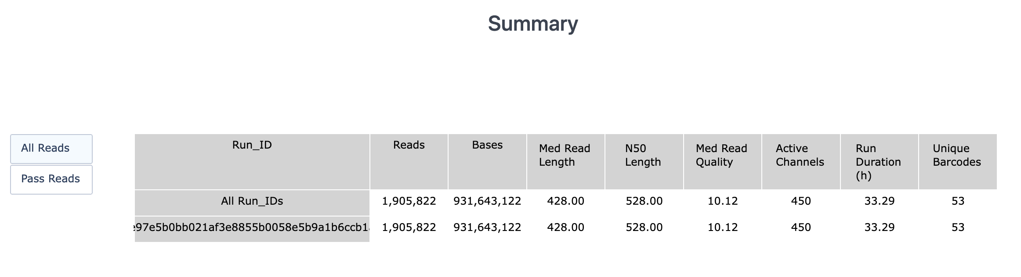
Quality control with PycoQC
PycoQC is a data visualisation and quality control tool for nanopore data.
It requires a specific file, the sequencing_summary.txt file generated by Oxford nanopore basecallers such as Guppy or the older albacore basecaller.
Provides read statistics, sequencing and flow cell information (sequencing run, yield over time, number of active pores)

Slide 17
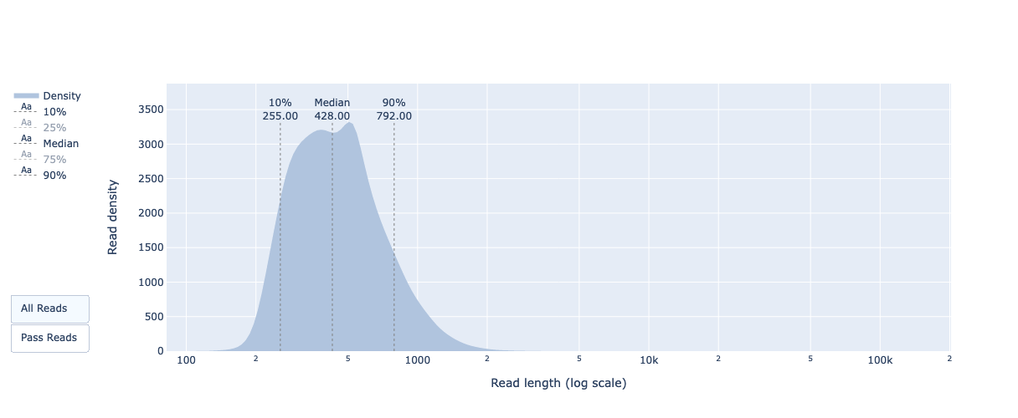
PycoQC – Distribution of read length

Slide 18
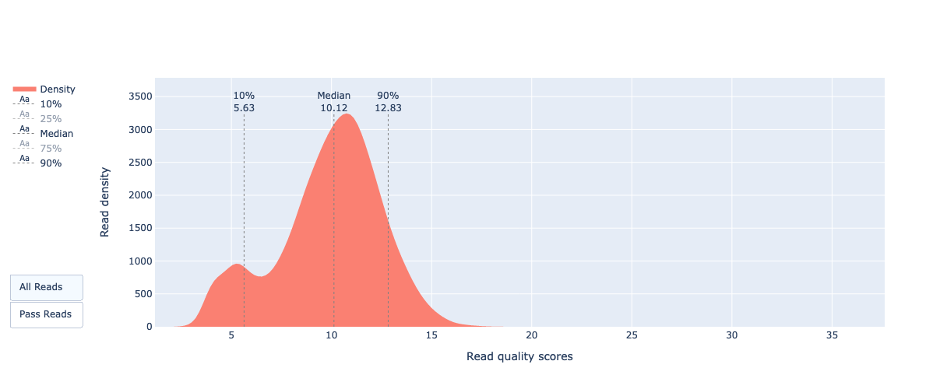
PycoQC – Distribution of read quality

Slide 19
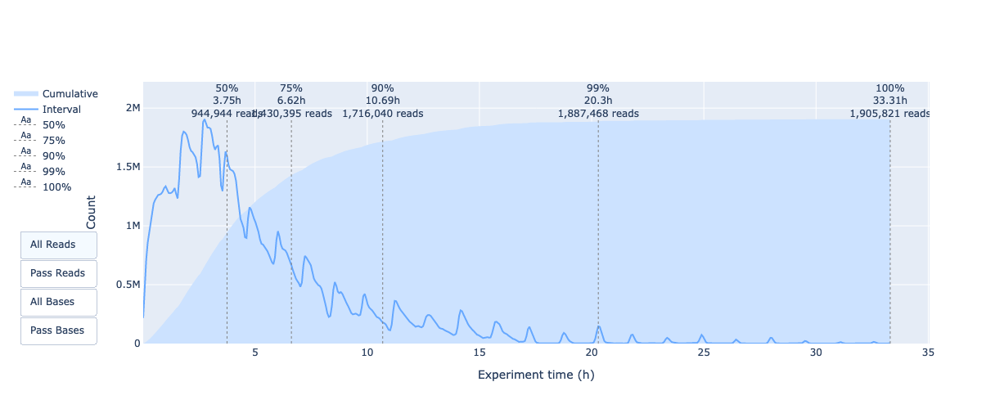
PycoQC – Output over experiment time

Slide 20
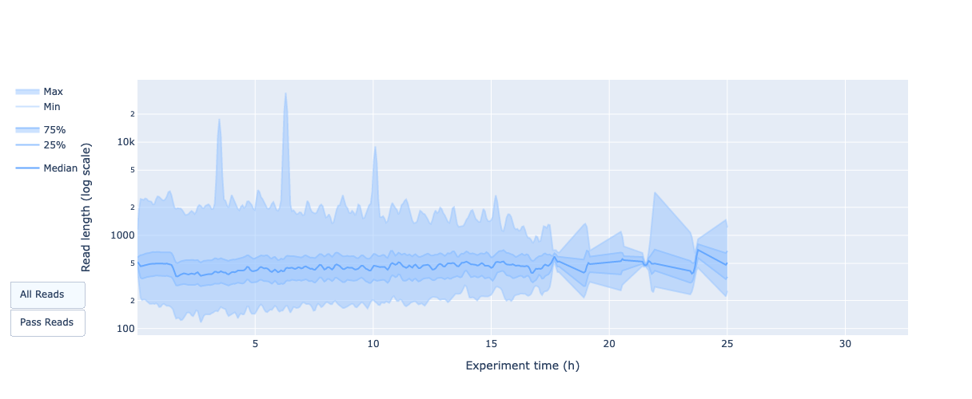
PycoQC – read length over time

Slide 21
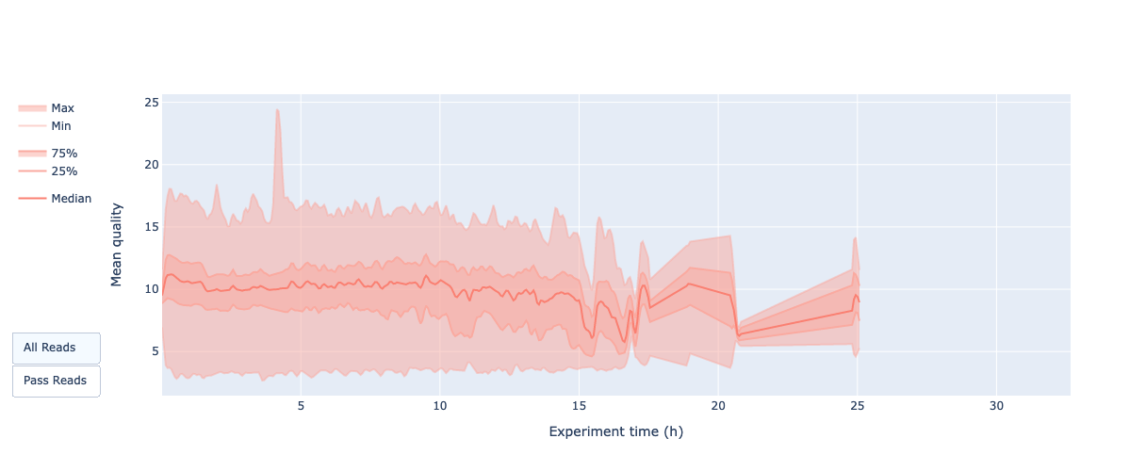
PycoQC – mean read quality over time

Slide 22

PycoQC – number of reads per barcode

Slide 23
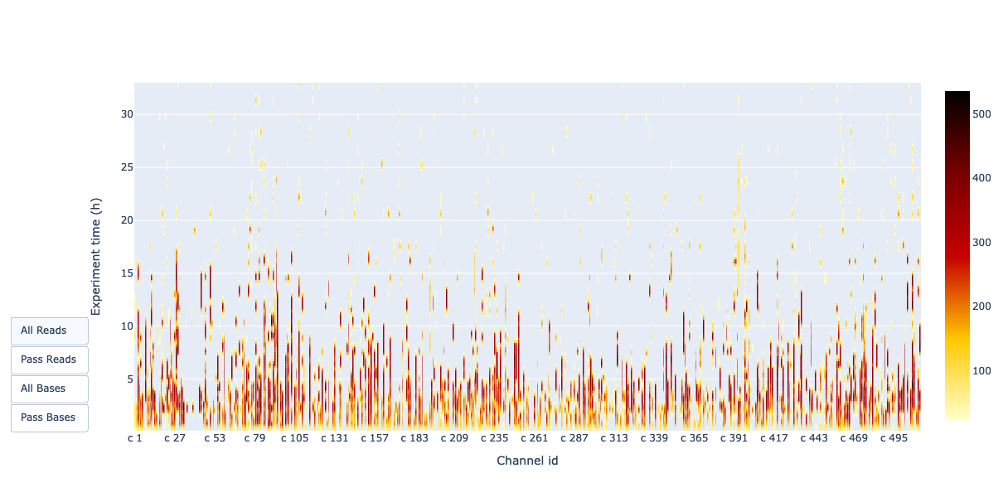
PycoQC – channel activity over time

Slide 24
Quality control using MinION_QC
Ability to compare multiple sequencing runs, e.g., to compare different library preparation or DNA extraction protocols used.
Takes in multiple sequencing summary files.

Slide 25
Read filtering: trimming and adapter removal
3rd generation sequencing platforms contain linker, barcode or adapter sequences at the read beginning or end.
Additionally, 2D library preparation protocols for ONT contain adapters in the middle.
Porechop – trim adapters if 2D libraries use the option –discard_middle
adapter removal is not necessary as they have no impact on current assemblers. (https://f1000research.com/articles/8-2138)
NanoFilt – Read trimming and filtering.
NanoFilt –l 500 --headcrop 10 < porechopped.fastq > nanofilt_trimmed.fastq

Slide 26
Alignment
A reference alignment of the basecalled reads against the reference sequence is the performed by minimap2 or bwa. Both aligners use their respective ONT presets. The alignments are filtered to keep only mapped reads, and then sorted and indexed.
Nearly all alignment methods rely on pre-processing the reference genome into a data-structure (like a suffix tree) that provides an index which makes it fast to find the place in a genome where a query sequence matches.
Such indexes can take up a large amount of computer memory. The Burrows-Wheeler Transform (BWT) provides a way of decreasing the size of such indexes. The BWT is an operation that takes a sequence of characters (in this case DNA bases) and re-orders them so that similar characters tend to appear together in long runs of the same character.

Slide 27
Burrows-Wheeler Transform
$attccggat
at$attccgg
attccggat$
ccggat$att
cggat$attc
gat$attccg
ggat$attcc
t$attccgga
tccggat$at
ttccggat$a
ttccggat$a
tccggat$at
ccggat$att
cggat$attc
ggat$attcc
gat$attccg
at$attccgg
t$attccgga
$attccggat
attccggat$
attccggat$
tg$tcgcata
M. Burrows and D. J. Wheeler, “A Block-Sorting Lossless Data Compression Algorithm,” Technical Report, 124, Digital Equipment Corporation, 1994.

Slide 28
Sequence Alignment Map
SAM – human readable format of the alignment
BAM – Binary format of the alignment, machine-readable format
FLAG
Position
Read ID
Reference
MAPQ
CIGAR

Slide 29
Sequence Alignment Map
SAM – human readable format of the alignment
BAM – Binary format of the alignment, machine-readable format
FLAG
Position
Read ID
Reference
MAPQ
CIGAR
Note:
Different alignment tools will output differently sorted SAM/BAM, and different downstream tools require differently sorted alignment files as input.

Slide 30
Post-alignment processing
The purpose of alignment post-processing is:
assign each read alignment to a derived amplicon
using the derived amplicon, assign each read a read group based on the primer pool
softmask read alignments within their derived amplicon
Also, there is the option to:
remove primer sequence by further softmasking the read alignments
normalise/reduce the number of read alignments to each amplicon
remove reads with imperfect primer pairing, e.g., from amplicon read through

Slide 31
Post-alignment processing steps
For each read we find the amplicon from which it originated by selecting the amplicon with the largest overlap with the read, we also find the next closest match.
We discard the read if the next closest match is a large proportion of the mutual overlap of the two amplicons. This is a guard against chimeric reads, either from library preparation or faults in the sequencing platform control software.
There is an option to only allow those reads that extend across the whole amplicon, if set to true then we check whether the alignment extends to the primer at each end, this is a “correctly paired” read.
To normalise we take the passing reads, sort by the amount of coverage they provide and take the 1st n reads.

Slide 32
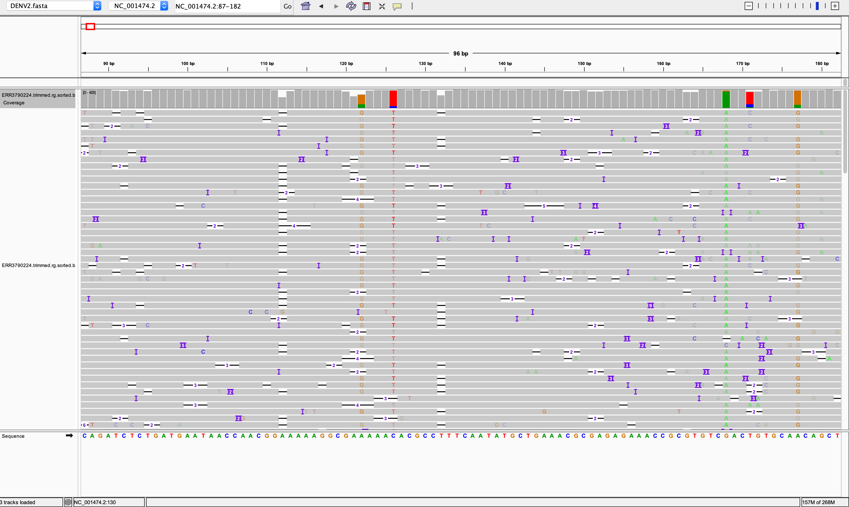
Visualizing alignment

Slide 33
Variant calling
Variant calling entails identifying single nucleotide polymorphisms (SNPs) and small insertions and deletion (indels) from next generation sequencing data.
The artic bioinformatics pipeline can use two variant callers:
Nanopolish
Medaka
If calling variants with Nanopolish, the raw data file having squiggles is REQUIRED.

Slide 34
Variant calling
For each read group (based on primer pools), variants are called then merged using artic_vcf_merge module.
The artic_vcf_filter module categorizes the variants as either PASS or FAIL. Variants that have passed are used in downstream steps.

Slide 35
Consensus building
Post-processed alignment is used to check each position of the reference sequence for sample coverage. Any position that is not covered by at least 20 reads from either read group are marked as low coverage. This is computed using artic_make_depth_mask module. This step produces coverage information for each read group and produces a coverage mask to tell us which coordinates in the reference sequence failed the coverage threshold.
A consensus sequence is built, first as a pre-consensus sequence based on the input reference sequence. The preconsensus has low quality sites masked out with N's using the coverage mask and the sample fail.vcf file. bcftools consensus is used to combine the preconsensus with the pass.vcf variants to produce a consensus sequence for the sample.

Slide 36
Depth
A T G C T A G C C T A G T A C G A T G G G T A C C A G T T T A C C G A T A C G A T A C G G
Reference genome
A T G C T A G C C T A G T A C G A T G G
T G G G T A C C A G T T T A
T A C G A T G G G T A C C A G T T T A C C G A T A C G
A T G C T A G C C T A G
T A C G A T A C G G
G G G T A C C A G T T T A C C G A T A C G A T A C G
T A C C A G T T T A C C G A T A C G A T A C G
T G C T A G C C T A G
2X
3X
4X
1X
Notes:
this is the number of times a base within a genome has been sequenced. The greater the depth, the greater the confidence in the identity of the sequenced base.

Slide 37
Coverage
A T G C T A G C C T A G T A C G A T G G G T A C C A G T T T A C C G A T A C G A T A C G G
Reference genome
A T G C T A G C C T A G
A T G C T A G C C T A G T A C G A T
T A C C A G T T T A
A T G C T A G C C T A G T C G A T A C G A T A C G G
A C C G A T A C G A T A C G G
39/45*100 = 86.66% ~87%
A T G C T A G C C T A G
T A C G A T A C G G
T A C C A G A C C G A T A C G A T A
A C C G A T A C G A T A C G G
A T G C T A G C T A C G A T A C G G
A T G C T A G C C T A G T A C G A T N N N T A C C A G N N N A C C G A T A C G A T A C G G
Consensus genome
Notes:
this is the percentage of the whole genome that has been sequenced

Slide 38
Acknowledgments

Slide 39
References and further reading

